Slide 1
Control Engineering
Course 3

Slide 2



The method of Truxal and Guillemin

Slide 3


The method of Truxal and Guillemin
The desired transfer function of the closed loop is given by:
The distribution of poles and zeros will be chosen, such that the performance indices for the step response are fulfilled
From the closed-loop transfer function

Slide 4
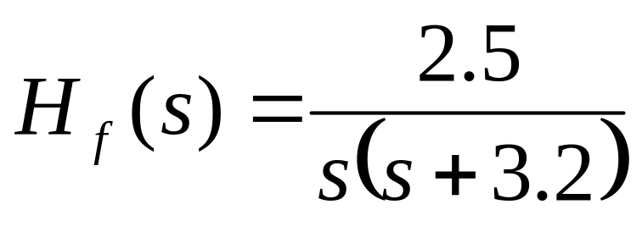
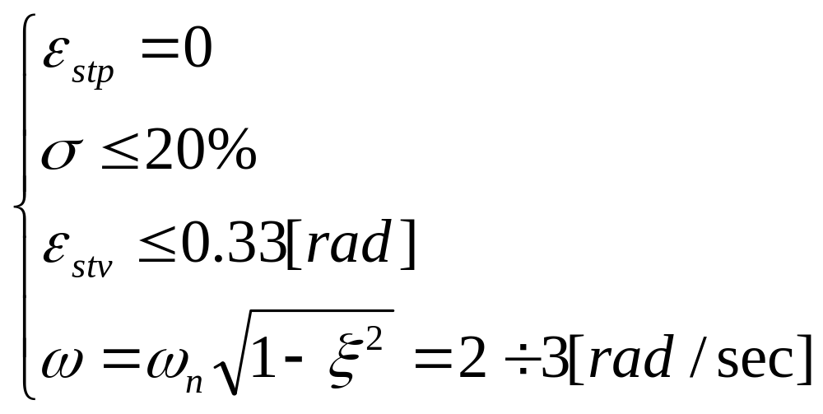
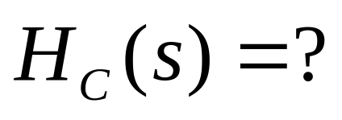
Example

Slide 5
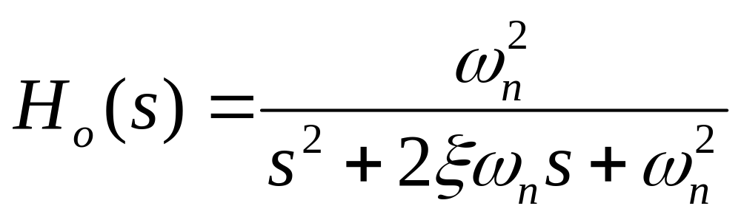
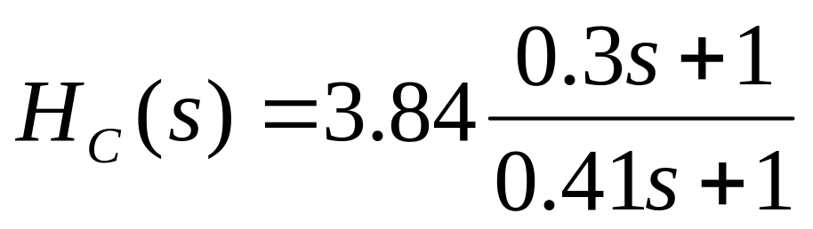
Example (cont.)
We impose
From the imposed performance measures we can compute the two unknown parameter (see lecture 2): ω_{n}=2.7 and ξ=0.45, resulting

Slide 6
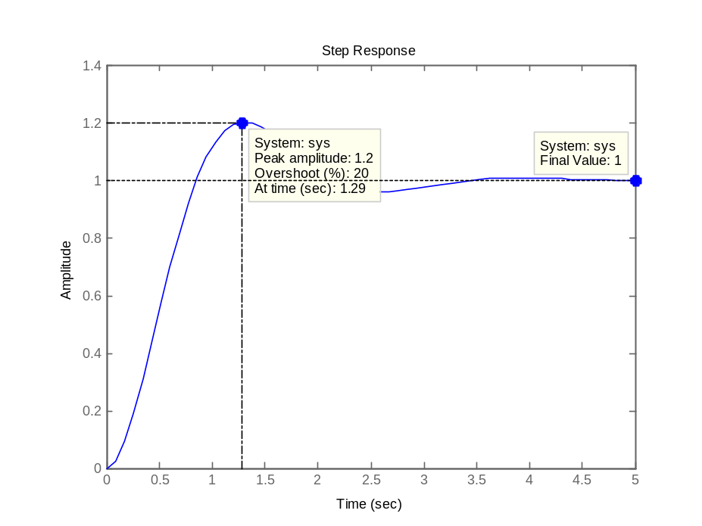
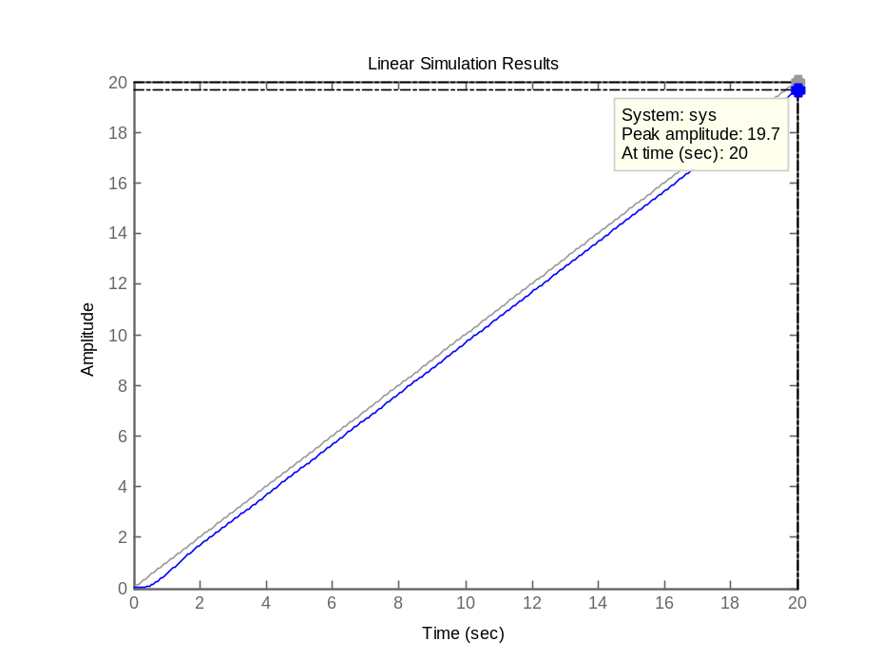
Example (cont.)

Slide 7
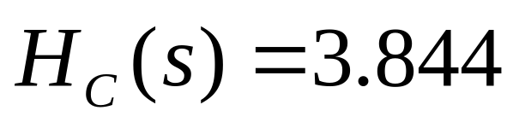
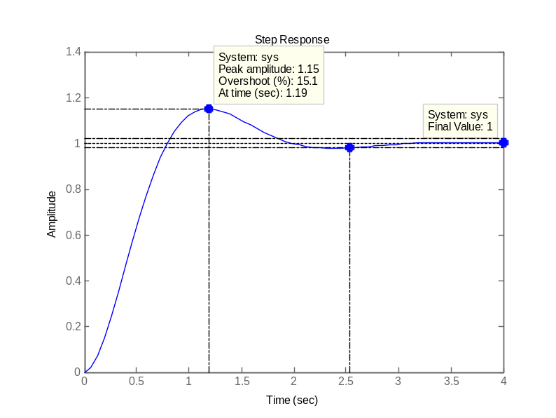

Example (cont.)
Almost the same performances can be achieved with ω_{n}=3.1 and ξ=0.516, resulting

Slide 8
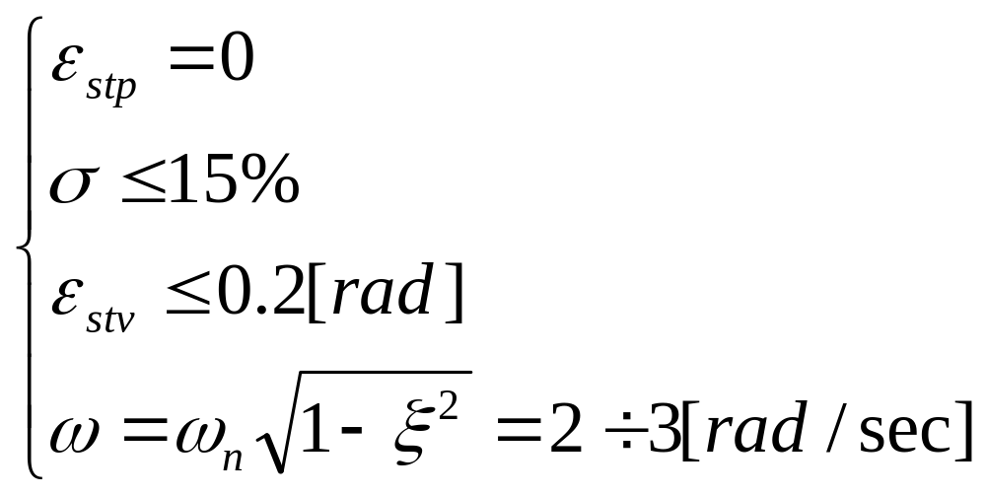
Homework
For the process transfer function from the previous example design a controller to achieve

